Slide 1

Web Development 1
© Hugh McCabe & Matt Smith 2008-2014
Lecture 5b
The CSS Box Model (part 2)
Width / height
Margins

Slide 2
Introduction
Every element in a HTML document generates a BOX in which the content is housed.
Properties such as width, height, padding, borders, background properties and so on can be applied.
In this lecture we are going to look at this box model in detail as it is the foundation of doing page layout with CSS.
In particular we will deal with:
Dimensions
Margins
Padding
Borders

Slide 3
The Element Box

Slide 4
The Element Box
As we have seen, every HTML element, both block-level or inline generates a rectangular element box.
The components of this box are shown below.
Outer Edge
Border
Inner Edge
Margin Area
Padding area
Content area
Height
Width

Slide 5
The Element Box
Outer Edge
Border
Inner Edge
Margin Area
Padding area
Content Area
The core of box.
Contains the content
Inner Edges
Edges of content area.
This gets sized by using the width and height properties. Always invisible on the page.
Padding Area
Area between content area and optional border.
Border: Optional line that surrounds content and its padding.
Margin: Optional space outside the border.
Outer Edge
The outside edge of margin area and therefore outside edge of entire element. Always invisible on the page.
Content area
Height
Width

Slide 6
Setting the Content Dimensions

Slide 7
Setting the element dimensions
Use the width and height properties to specify the width and height of the element.
You can specify the width and height only of block-level elements or non-text inline elements such as images.
width or height
values: length measurement | percentage | auto | inherit
default: auto
applies to: block level elements and non-text inline elements
inherits: no
By default the width and height of an element is calculated automatically by the browser.
Hence the default setting of auto.

Slide 8
Setting the element dimensions
However you can use the width and height properties to set this yourself – usual values to give are em, pixel or percentage values.
Here are some examples of using them:
.wide { width: 40rem; height: 10rem; }
.narrow { width: 15rem; height: 30rem; }
Slide overleaf shows the results of formatting the same paragraph twice with the two different style rules above. A green background has been added for clarity.

Slide 9
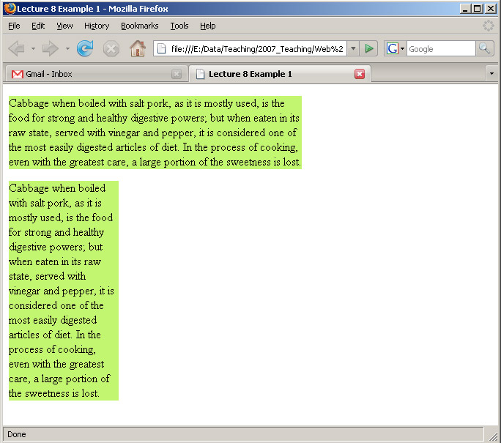
Setting the Content Dimensions
uses rule .wide
.wide { width: 40rem; height: 10rem; }
.narrow { width: 15rem; height: 30rem; }
uses rule .narrow

Slide 10
Height … good reason not to set this for most web pages …

Slide 11
Setting the Content Dimensions
In general you don’t specify the height of elements.
It’s usually better to let the browser figure this out based on how much content there is.
If you do specify height though, you must consider what happens if the content does not fit. This situation is called overflow.
There is a property called overflow which can be used to specify this. There are five predefined values it can take
visible, hidden, scroll, auto, inherit
Next slide shows examples …

Slide 12
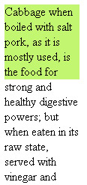
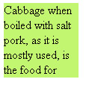
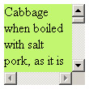
Setting the Content Dimensions: OVERFLOW
visible
hidden
scroll
The auto option just lets the browser
decide what to do … i.e. it will add
Scroll-bars when overflow begins …

Slide 13
Margins (spacing OUTSIDE border)

Slide 14
Margins
Last remaining component of the box is the margin.
An optional amount of space added outside border.
Outer Edge
Border
Inner Edge
Margin Area
Padding area
Content area
Height
Width

Slide 15
Margins: keep elements from bumping into one another
Can use them to make space for another column or content
Margins work similarly padding ..
margin
values: length | percentage| auto | inherit
default: auto
applies to: all elements
inherits: no
margin-top, margin-right, margin-bottom, margin-left
values: length | percentage| auto | inherit
default: auto
applies to: all elements
inherits: no

Slide 16
Margins
To add margin just specify an amount
use rems !!!!
If use margin it addes the same amount on all sides
If want different amounts on different sides then use margin-left, margin-top etc.
Following slides show some examples of adding margins to paragraph elements.

Slide 17
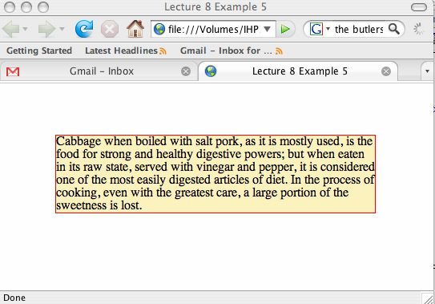
Margins
p {
margin: 4rem;
border: 0.1rem solid red;
background: #FCF2BE;
}

Slide 18
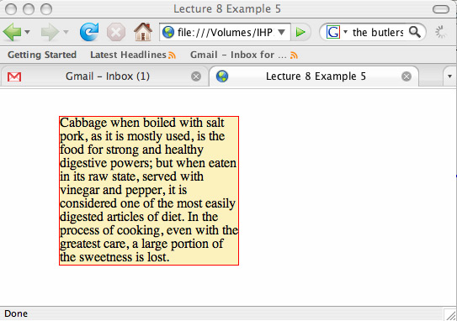
Margins
p {
margin-top: 2rem;
margin-right: 25rem;
margin-bottom: 1rem;
margin-left: 4rem;
border: 0.1rem solid red;
background: #FCF2BE;
}

Slide 19
Collapsing Margins

Slide 20
Margins
Collapsing Margins
The most important one is that neighbouring ones collapse.
Suppose you have two adjacent elements that both have margins, for example two paragraphs.
The gap between the elements will not be the sum of the two margins.
The gap between the elements is equivalent to the larger margin i.e. they collapse into one another.
Example on next slide.

Slide 21
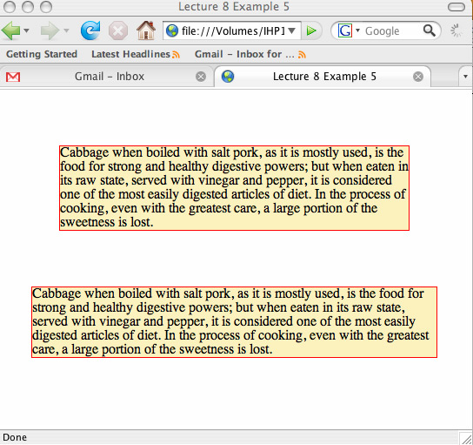
Margins
4rem
1st paragraph has margin
of 4rem all around
4rem
4rem
Gap is 4 rem !!!!!!!!
NOT: 2 + 4 = 6 rem
4rem
2rem
2rem
2nd one has margin
of 2rem all around

Slide 22
Margins on inline elements

Slide 23
Margins
Margins on inline elements
These behave a little differently to what you might expect.
Basically, applying top and bottom margins will have no effect but applying left and right ones will.
So suppose we make a style rule for an em element that includes an all round margin.
em { margin: 2rem; }
See next slide for what happens…
Keep life simple leave inline element margins alone ..

Slide 24
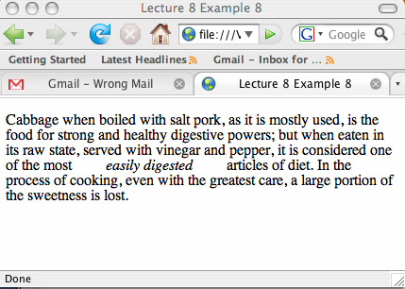
Margins
2rem gap

Slide 25
Keep life simple
leave inline element margins alone ..
If you need to control such things then …
Make elements display as BLOCK
Or perhaps INLINE-BLOCK
But that’s getting into complicated stuff – leave for another day

Slide 26
Margins
The exception to this behaviour is that image elements (img) will display margins top and bottom as well and left and right
Images have a physical width and height (pixel array!)

Slide 27
Summary and Conclusions

Slide 28
Summary / Conclusions …
Box model
Spacing and size of elements
Different for BLOCK LEVEL and INLINE elements
Content / padding / borders / margins
Default for width/height is content-box
But box-sizing can use border-box
Generally don’t specify height
Need to anticipate OVERFLOW
Can force elements to display BLOCK or INLINE
i.e. different to their defaults
Very handy for nav-bars … more in a later week …

